Slide 1


GRADUATE APPLICATIONS
Writing Support Desk
writingsupport@uwindsor.ca

Slide 2
FOUR PARTS
1. Personal Narrative
2. Academic Qualifications
3. Professional Experience
4. Scholastic Suitability

Slide 3
PART ONE:
PERSONAL NARRATIVE

Slide 4

PRO TIP: Don't start by stating your school and degree... everyone's will be similar!
4

Slide 5

YOUR ORIGIN STORY
Helps you stand out
Frames you as a person
Illuminates your background and motivations
Hooks the reader into your narrative
8

Slide 6

NARROW YOUR FOCUS
Propose a thesis topic/idea
What led you to this idea?
Set out groundwork for your scholarly interests
8

Slide 7

INFLUENCES
Note relevant theories, works, & experts
Shows familiarity with the field
May appear in 'Academic Qualifications' instead
8

Slide 8

CONTRIBUTIONS
How will your work contribute to
the school?
your field?
the world?
8

Slide 9

EXAMPLE
...As an English student captivated by [Charlotte Perkins] Gilman's dissenting voice in “The Yellow Wallpaper,” I considered the paradox of writing oneself into the canon and into psychiatric care at once. (origin story)
I am interested in exploring the ways in which North American female writers from the realist and modern periods represent “mad” female voices. How do women writers negotiate mental illness and authorship? (narrow focus)
French feminist thinkers such as Hélène Cixous propose an écriture féminine, a uniquely female style and voice of writing. Is there a uniquely female voice of literary madness and what characteristics define this voice? (theorist)
There is a wealth of theoretical work on both topics of female literary madness and voice; however, I am interested in exploring how these elements come together to either subvert or perpetuate gender norms that contribute to coding women as mad. (contribution)
8

Slide 10
PART TWO:
ACADEMIC
QUALIFICATIONS

Slide 11

PRO TIP: Don't boast about high grades. Many students have high GPAs; this won't help you stand out.
4

Slide 12

PRO TIP: Don't just list classes you have taken. Most degrees have standard classes, so you won't stand out.
4

Slide 13
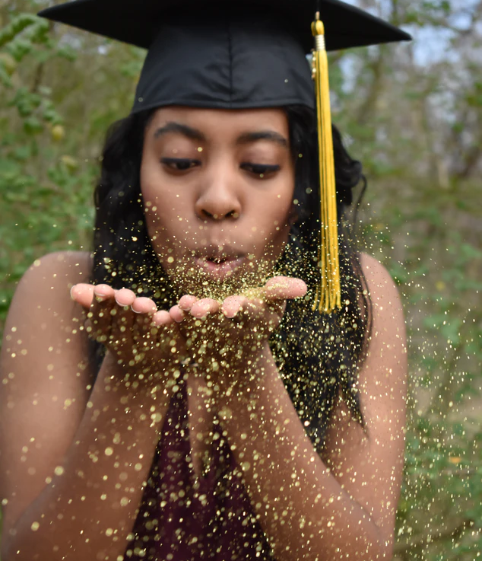
DO INCLUDE
Your degree & school (just don't start with this)
Awards, grants, & scholarships (shows success beyond grades + grant-writing ability)
Courses/works that influenced you
Major papers, conferences, & publications
8

Slide 14

EXAMPLE
Over the course of my academic career at the University of Windsor, I explored my interest in the implications of female literary madness often.
In a third-year gender and literature course, I wrote on the humanizing influence of autobiography and first-person narration in “The Yellow Wallpaper” and Sylvia Plath's “The Bell Jar.” During the final year of my undergraduate degree, I researched the coding of Katherina Minola as “mad” in Shakespeare's The Taming of the Shrew and proposed that this coding acts as a reaction and damper to her subversive female agency. (major papers/courses)
8

Slide 15
PART THREE:
PROFESSIONAL
EXPERIENCE

Slide 16

PRO TIP: Don't include every job you've had. Stick to relating relevant experience (& save the rest for your CV).
4

Slide 17

DO INCLUDE
TAships & GAships (academic work)
Relevant work experience to your field (practicums, internships, etc.)
Volunteerism relevant to your field
Be sure to relate this to your field/studies
8

Slide 18
PART FOUR:
SCHOLASTIC
SUITABILITY

Slide 19

PRO TIP: Don't use a 'cookie cutter' application for each school. They'll assume you don't know anything about their institution.
4

Slide 20

DO INCLUDE
Why that school in particular?
What resources would be useful to you? Their library? Specific collections?
Look for profs who have expertise that matches your interests
Shows that you took researching the school seriously
8

Slide 21
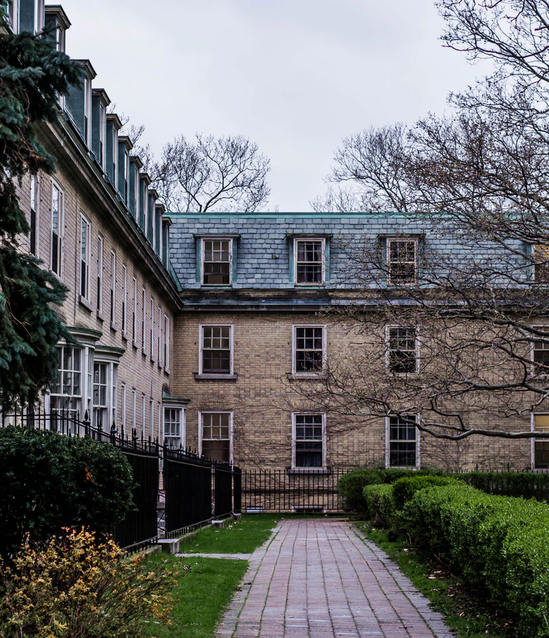
EXAMPLE
The University of Toronto's program would be the ideal setting in which to explore these ideas...[as] the coursework will allow me to engage with a variety of depictions of female voice and literary madness and prepare me for future research. (school suitability)
Dr. Marlene Goldman, who has researched women's writing heavily, has a significant body of work in hysteria and madness. Her input and expertise would therefore be invaluable to my studies, as would her courses such as “Madness and Canadian Literature.” (course/professor suitability)
8

Slide 22

Personal narrative regarding how you developed your interest
Academic credentials (degree, school, scholarships, grants, publications, major papers, conferences)
Professional experience work/internship/volunteer (related to field!)
School selection (why this school, why this prof as supervisor, what resources, etc.)

Slide 23
Writing Support DOES NOT offer one-on-one consultations for graduate applications
Instead, book a consultation with Career Services via mySuccess
You can also seek help from one of the professors you have asked for a reference
HOW TO FIND
MORE
HELP!

Slide 24
QUESTIONS?
Remember, this slideshow and many others are available to download via the Writing Support Brightspace page.
Students can self-enroll as 'learners' either by selecting 'Discover' from the Brightspace landing page and clicking 'Enroll' on the Writing Support organization.

